Slide 1



Introduction to Deep Learning
MIT 6.S191
Alexander Amini

Slide 2



What is Deep Learning?
ARTIFICIAL INTELLIGENCE
Any technique that enables computers to mimic human behavior
MACHINE LEARNING
Ability to learn without
explicitly being programmed
DEEP LEARNING
Learn underlying features in data using neural networks
6.S191 Introduction to Deep Learning
introtodeeplearning.com
1/29/18

Slide 3
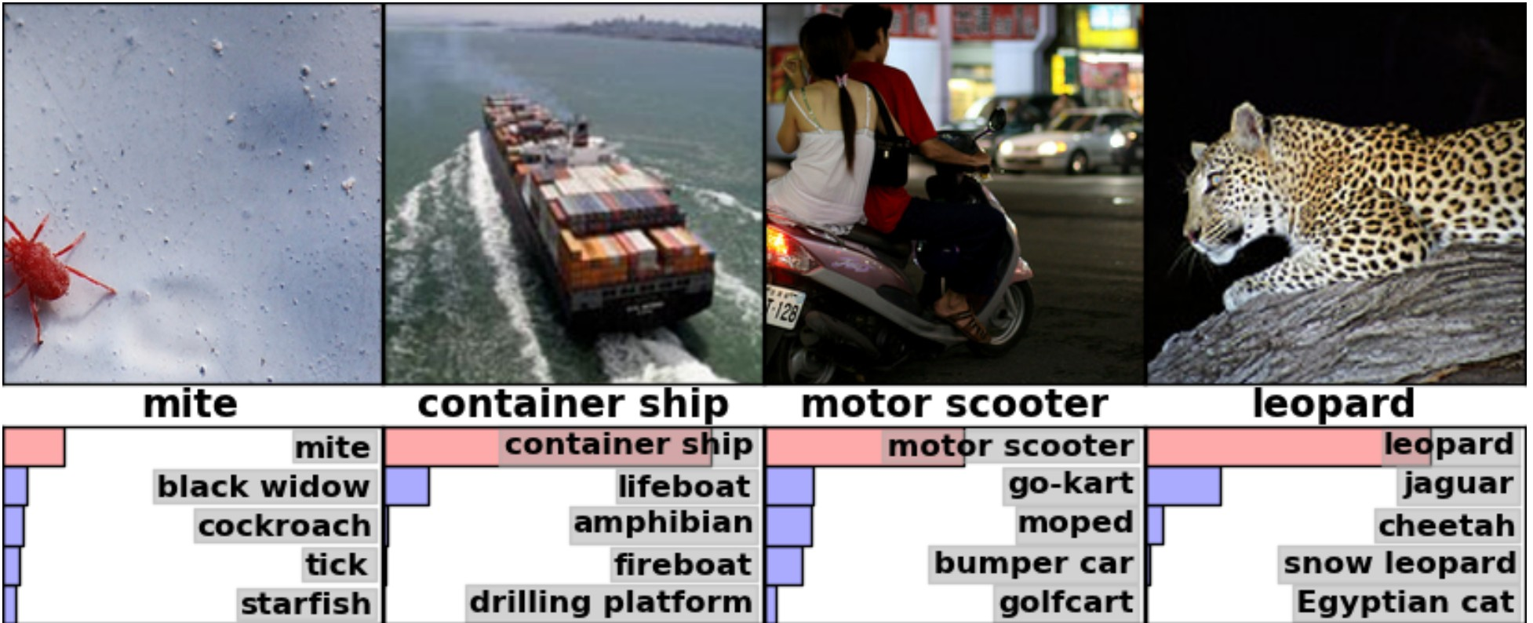
Deep Learning Success: Vision
Image Recognition
6.S191 Introduction to Deep Learning
introtodeeplearning.com
1/29/18

Slide 4
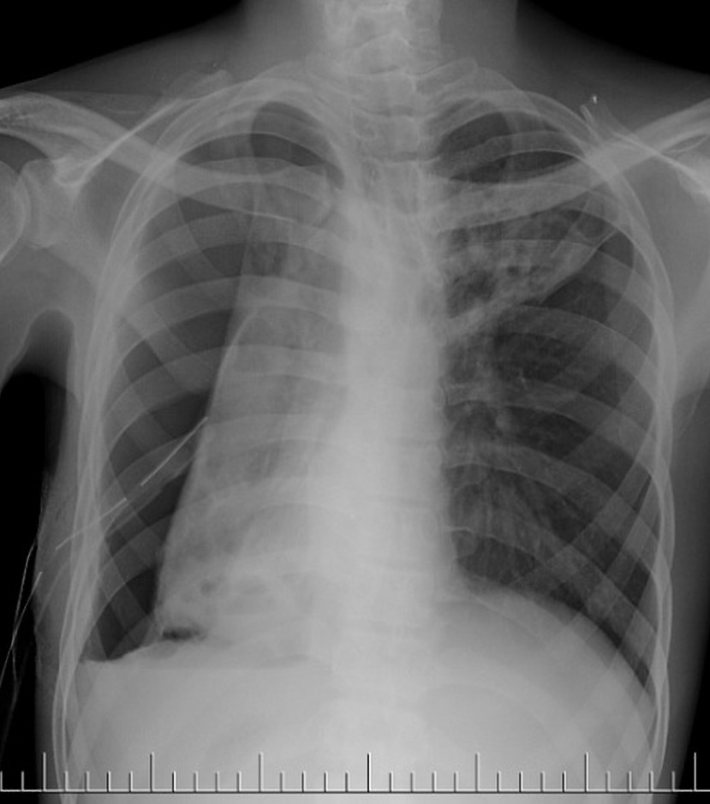
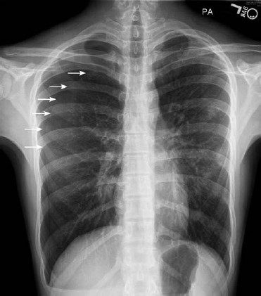
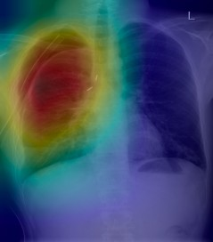
Deep Learning Success: Vision
6.S191 Lab!
Detect pneumothorax in real X-Ray scans
6.S191 Introduction to Deep Learning
introtodeeplearning.com
1/29/18

Slide 5
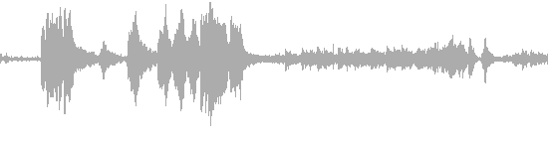
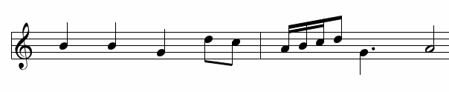
Deep Learning Success: Audio
6.S191 Lab!
Music Generation
6.S191 Introduction to Deep Learning
introtodeeplearning.com
1/29/18

Slide 6
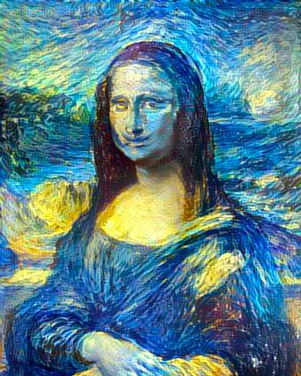
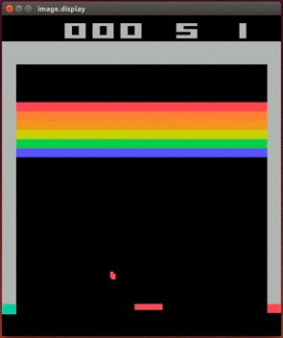
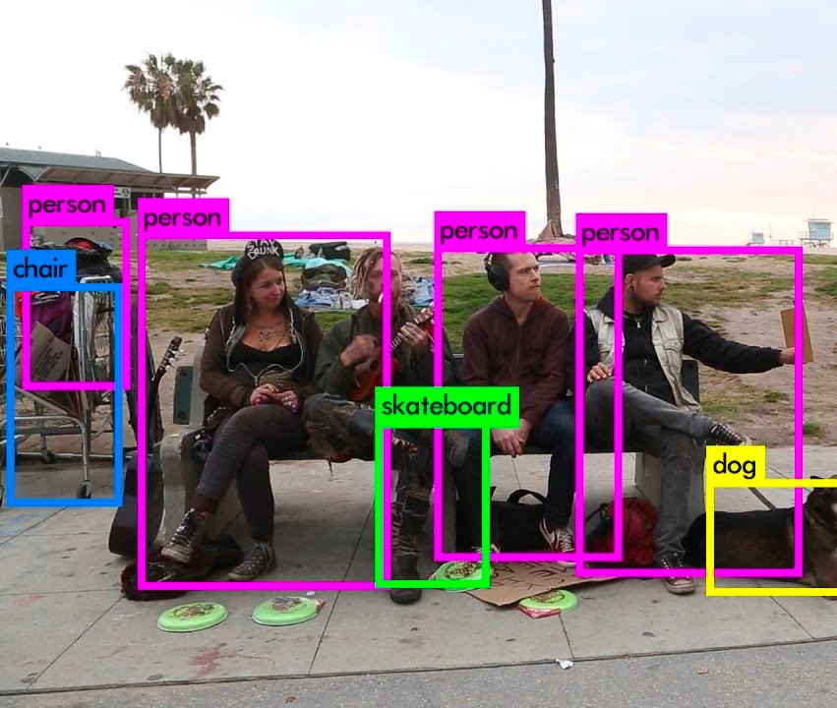
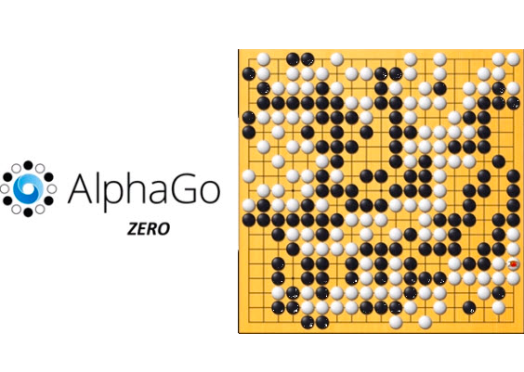
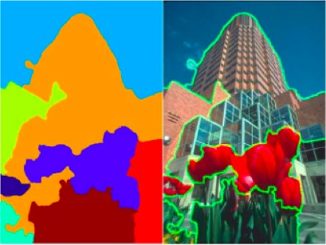
Deep Learning Success
And so many more…
6.S191 Introduction to Deep Learning
introtodeeplearning.com
1/29/18

Slide 7






Thanks to Sponsors!
6.S191 Introduction to Deep Learning
introtodeeplearning.com
1/29/18

Slide 8
Why Deep Learning and Why Now?

Slide 9
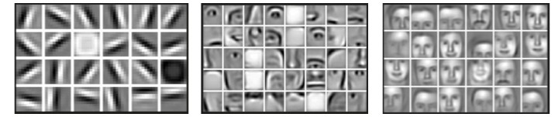
Why Deep Learning?
Hand engineered features are time consuming, brittle and not scalable in practice Can we learn the underlying features directly from data?
Low Level Features
Mid Level Features
High Level Features
Lines & Edges
Eyes & Nose & Ears
Facial Structure

Slide 10


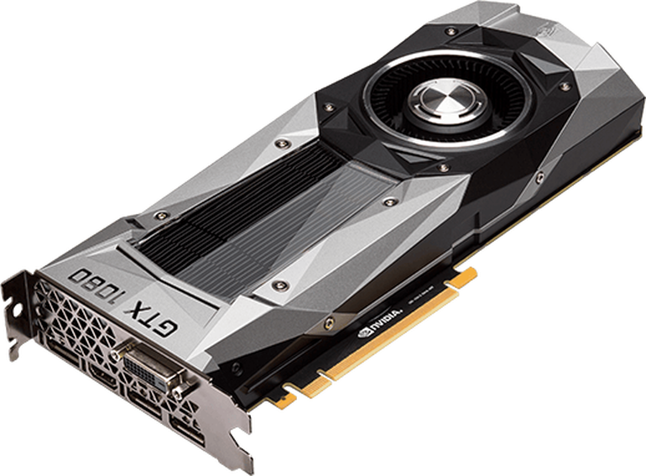


Why Now?
Neural Networks date back decades, so why the resurgence?
1952
Stochastic Gradient Descent
Perceptron
1. Big Data
Larger Datasets
Easier
Collection & Storage
2. Hardware
3. Software
Improved Techniques
New Models
Toolboxes
1958
Learnable Weights
Graphics Processing Units (GPUs)
Massively Parallelizable
1986
Backpropagation
Multi-Layer Perceptron
Deep Convolutional NN
Digit Recognition
1995

Slide 11
The Perceptron
The structural building block of deep learning

Slide 12
The Perceptron: Forward Propagation
Linear combination of inputs
Output
𝑥#
�#
$
,
- . #
�) = 𝑔
𝑥₋ 𝜃₋
�%
Σ
𝑥
%
�)
�$
Non-linear activation function
𝑥$
Inputs
Weights
Sum
Non-Linearity
Output

Slide 13
The Perceptron: Forward Propagation
Linear combination of inputs
1
Output
�/
$
𝜃/ + , 𝑥₋ 𝜃₋
- . #
𝑥#
�#
�%
�$
�) = 𝑔
Σ
�)
𝑥%
Non-linear activation function
Bias
𝑥$
Inputs
Weights
Sum
Non-Linearity
Output

Slide 14
The Perceptron: Forward Propagation
1
�/
$
𝜃/ + , 𝑥₋ 𝜃₋
- . #
�) = 𝑔
𝑥#
�#
�%
�$
Σ
�)
�) = 𝑔
3
𝜃/ + 𝑿𝜽
𝑥#
𝑥%
𝜃#
⋮
𝜃$
where: 𝑿=
⋮
𝑥$
and 𝜽=
𝑥$
Inputs
Weights
Sum
Non-Linearity
Output

Slide 15
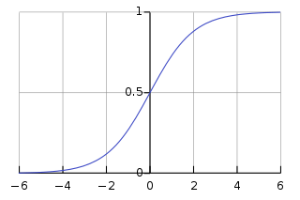
The Perceptron: Forward Propagation
Activation Functions
1
�/
�) = 𝑔
𝜃/ + 𝑿³ 𝜽
𝑥#
�#
�%
�$
Σ
�)
Example: sigmoid function
𝑥%
1
𝑔𝑧= 𝜎𝑧=
1 + 𝑒^{9 :}
𝑥$
Inputs
Weights
Sum
Non-Linearity
Output
𝑧
6.S191 Introduction to Deep Learning
introtodeeplearning.com
1/29/18

Slide 16
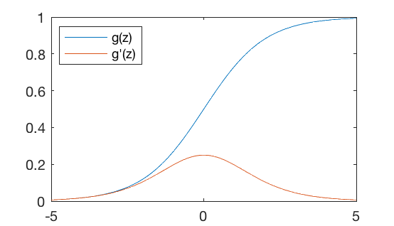
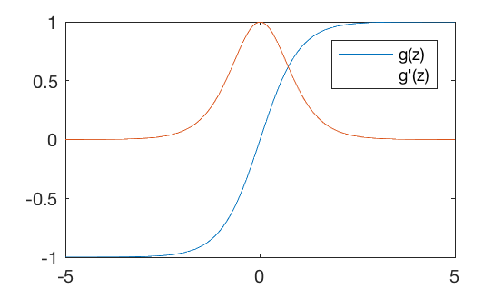
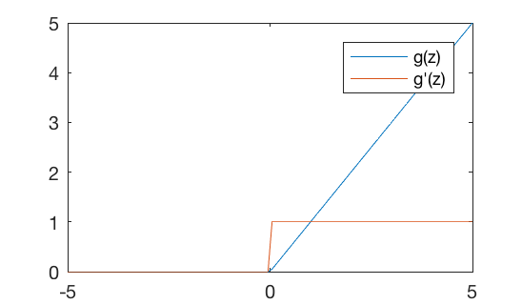

Common Activation Functions
Sigmoid Function
Hyperbolic Tangent
Rectified Linear Unit (ReLU)
1
_{𝑒}: _{− 𝑒}9 :
𝑔𝑧=
𝑔𝑧=
_{𝑒}: _{+ 𝑒}9 :
𝑔𝑧
= max ( 0 , 𝑧)
1 + 𝑒^{9 :}
𝑔′ 𝑧
= 𝑔(𝑧) 1 − 𝑔(𝑧)
𝑔′ 𝑧= 1 − 𝑔(𝑧)%
𝑔′ ( 𝑧) = D ^{1 ,}
𝑧> 0 otherwise
0 ,
tf.nn.sigmoid(z)
tf.nn.tanh(z)
tf.nn.relu(z)
NOTE: All activation functions are non-linear
6.S191 Introduction to Deep Learning
introtodeeplearning.com
1/29/18

Slide 17
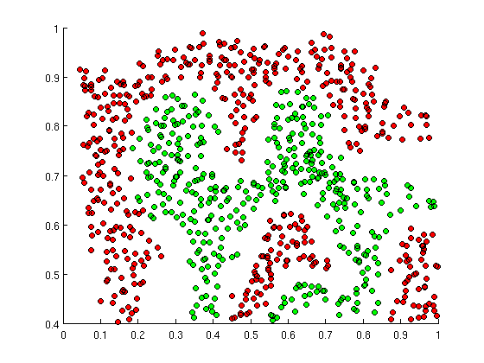
Importance of Activation Functions
The purpose of activation functions is to introduce non-linearities into the network
What if we wanted to build a Neural Network to
distinguish green vs red points?
6.S191 Introduction to Deep Learning
introtodeeplearning.com
1/29/18

Slide 18
Importance of Activation Functions
The purpose of activation functions is to introduce non-linearities into the network
Linear Activation functions produce linear
decisions no matter the network size
6.S191 Introduction to Deep Learning
introtodeeplearning.com
1/29/18

Slide 19
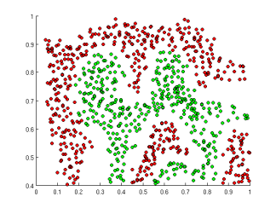
Importance of Activation Functions
The purpose of activation functions is to introduce non-linearities into the network
Linear Activation functions produce linear decisions no matter the network size
Non-linearities allow us to approximate arbitrarily complex functions
6.S191 Introduction to Deep Learning
introtodeeplearning.com
1/29/18

Slide 20
The Perceptron: Example
We have: 𝜃/ = 1 and 𝜽=
3
− 2
1
1
�) = 𝑔
= 𝑔1 +
𝜃/ + 𝑿³ 𝜽
3
Σ
𝑥#
𝑥%
3
3
− 2
𝑥#
�)
−2
�) = 𝑔( 1 + 3 𝑥# − 2 𝑥% )
𝑥%
This is just a line in 2D!
6.S191 Introduction to Deep Learning
introtodeeplearning.com
1/29/18

Slide 21
The Perceptron: Example
�) = 𝑔( 1 + 3 𝑥# − 2 𝑥% )
𝑥%
1
1
3
Σ
𝑥#
�)
−2
𝑥
#
𝑥%
6.S191 Introduction to Deep Learning
introtodeeplearning.com
1/29/18

Slide 22
The Perceptron: Example
�) = 𝑔( 1 + 3 𝑥# − 2 𝑥% )
𝑥%
1
1
−1
2
3
Σ
𝑥#
�)
−2
𝑥
#
𝑥%
− 1
2
Assume we have input: 𝑿=
�) = 𝑔1 + 3 ∗ −1 − 2 ∗ 2
= 𝑔−6 ≈ 0.002
6.S191 Introduction to Deep Learning
introtodeeplearning.com
1/29/18

Slide 23
The Perceptron: Example
�) = 𝑔( 1 + 3 𝑥# − 2 𝑥% )
𝑥%
1
1
𝑧< 0
𝑦< 0.5
3
Σ
𝑥#
�)
−2
𝑥
#
𝑥%
𝑧> 0
𝑦> 0.5
6.S191 Introduction to Deep Learning
introtodeeplearning.com
1/29/18

Slide 24
Building Neural Networks with Perceptrons

Slide 25
The Perceptron: Simplified
1
�/
𝑥#
�#
�%
�$
Σ
�)
𝑥%
𝑥$
Inputs
Weights
Sum
Non-Linearity
Output

Slide 26
The Perceptron: Simplified
𝑥#
𝑦= 𝑔𝑧
𝑥%
𝑧
𝑥$
$
𝑧= 𝜃/ + ,
�_{V} �_{V}
V.#

Slide 27
Multi Output Perceptron
𝑥#
�# = 𝑔𝑧#
𝑧#
𝑥%
�% = 𝑔𝑧%
𝑧%
𝑥$
$
𝑧₋
= 𝜃/, + ,
�_{V} �_{V}
-
,-
V.#

Slide 28
Single Layer Neural Network
_{𝜽}(#)
_{𝜽}(%)
𝑧#
𝑔𝑧#
𝑥#
𝑔𝑧%
𝑧%
�)#
𝑥%
𝑧_{W}
�)%
𝑔𝑧_{W}
𝑥$
𝑧_{XY}
𝑔𝑧
X_{Y}
Inputs
Hidden
Final Output
(#)
$
(#)
(%)
X_{Y}
(%)
𝑧₋ = �_{/,-} + ,
^{𝑥}V �V,-
�)₋ = �_{/,-} + ,
^{𝑧}V �V,-
V.#
V.#

Slide 29
Single Layer Neural Network
𝑧#
𝑥#
(#)
�#,%
(#)
𝑧%
�)#
�%,%
𝑥%
_{𝜃}(#)
𝑧_{W}
�)%
$,%
𝑥$
𝑧_{XY}
(#)
$
(#)
𝑧% = �/,%
+ ,
�V �V,%
V.#
(#) _{+ 𝑥}
_{𝜃}(#) _{+ 𝑥}
_{𝜃}(#) _{+ 𝑥}
_{𝜃}(#)
^{= �}/,%
#
#,%
%
%,%
$
$,%

Slide 30
Multi Output Perceptron
𝑧#
𝑥#
𝑧%
�)#
𝑥%
𝑧_{W}
�)%
𝑥$
𝑧_{XY}
Inputs
Hidden
Output

Slide 31
Deep Neural Network
^{𝑧}Z,#
𝑥#
^{𝑧}Z,%
�)#
⋯
⋯
𝑥%
^{𝑧}Z,W
�)%
𝑥$
^{𝑧}Z,X[
Inputs
Hidden
Output
(Z)
^{X}[\Y
(Z)
𝑧_{Z,-} = �_{/,-} + ,
𝑔(𝑧_{Z9#,V}) �_{V,-}
V.#

Slide 32
Applying Neural Networks

Slide 33
Example Problem
Will I pass this class?
Let’s start with a simple two feature model
𝑥# = Number of lectures you attend
𝑥% = Hours spent on the final project

Slide 34
Example Problem: Will I pass this class?
𝑥% = Hours spent on the final project
Legend
Pass Fail
𝑥# = Number of lectures you attend
6.S191 Introduction to Deep Learning
introtodeeplearning.com
1/29/18

Slide 35
Example Problem: Will I pass this class?
𝑥% = Hours spent on the final project
Legend
Pass Fail
?
4
5
𝑥# = Number of lectures you attend
6.S191 Introduction to Deep Learning
introtodeeplearning.com
1/29/18

Slide 36
Example Problem: Will I pass this class?
𝑧#
𝑥#
_{𝑥}#
= 4 , 5
𝑧%
�)#
Predicted: 0.1
𝑥%
𝑧_{W}
6.S191 Introduction to Deep Learning
introtodeeplearning.com
1/29/18

Slide 37
Example Problem: Will I pass this class?
𝑧#
𝑥#
_{𝑥}#
= 4 , 5
Predicted: 0.1 Actual: 1
𝑧%
�)#
𝑥%
𝑧_{W}
6.S191 Introduction to Deep Learning
introtodeeplearning.com
1/29/18

Slide 38
Quantifying Loss
The loss of our network measures the cost incurred from incorrect predictions
𝑧#
𝑥#
_{𝑥}#
= 4 , 5
Predicted: 0.1 Actual: 1
𝑧%
�)#
𝑥%
𝑧_{W}
ℒ 𝑓𝑥⁽⁻⁾; 𝜽, 𝑦⁽⁻⁾
Predicted Actual
6.S191 Introduction to Deep Learning
introtodeeplearning.com
1/29/18

Slide 39
Empirical Loss
The empirical loss measures the total loss over our entire dataset
𝑧#
𝑓(𝑥)
𝑦
4, 5
2, 1
5, 8
⋮ ⋮
0.1 ✖ 1
0.8 ✖ 0
0.6 ✔ 1
⋮
𝑥#
𝒙=
𝑧%
�)#
𝑥%
⋮
𝑧_{W}
1
e
𝑱𝜽
= _{𝑛},
ℒ 𝑓𝑥
(-)
; 𝜃, 𝑦
(-)
Also known as:
Objective function
Cost function
Empirical Risk
-.#
Predicted
Actual
6.S191 Introduction to Deep Learning
introtodeeplearning.com
1/29/18

Slide 40
Binary Cross Entropy Loss
Cross entropy loss can be used with models that output a probability between 0 and 1
𝑧#
𝑓(𝑥) 𝑦
4, 5
2, 1
5, 8
⋮ ⋮
0.1 ✖ 1
0.8 ✖ 0
0.6 ✔ 1
⋮
𝑥#
𝒙=
𝑧%
�)#
𝑥%
⋮
𝑧_{W}
1
e
𝑱𝜽
= _{𝑛},
(-)
-
(-)
-
𝑦 log
𝑓𝑥; 𝜃
+ (1 − 𝑦) log
1 − 𝑓𝑥; 𝜃
-.#
Actual Predicted Actual Predicted
loss =
tf.reduce_mean(
tf.nn.softmax_cross_entropy_with_logits(model.y,
model.pred) )

Slide 41
Mean Squared Error Loss
Mean squared error loss can be used with regression models that output continuous real numbers
𝑧#
𝑓(𝑥) 𝑦
4, 5
2, 1
5, 8
⋮ ⋮
30 ✖ 90
80 ✖ 20
𝑥#
𝒙=
𝑧%
�)#
85 ✔ 95
𝑥%
⋮ ⋮
𝑧_{W}
1
e
%
𝑱𝜽
= _{𝑛}, 𝑦
-
-
Final Grades (percentage)
− 𝑓𝑥; 𝜃
-.#
Actual Predicted
tf.square(tf.subtract(model.y,
loss
= tf.reduce_mean(
model.pred) )

Slide 42
Training Neural Networks

Slide 43
Loss Optimization
We want to find the network weights that achieve the lowest loss
e
𝜽∗ = argmin ¹ ,
ℒ 𝑓𝑥⁽⁻⁾; 𝜽, 𝑦⁽⁻⁾
𝜽
𝑛
-.#
𝜽∗ = argmin 𝐽(𝜽)
𝜽
6.S191 Introduction to Deep Learning
introtodeeplearning.com
1/29/18

Slide 44
Loss Optimization
We want to find the network weights that achieve the lowest loss
e
𝜽∗ = argmin ¹ ,
ℒ 𝑓𝑥⁽⁻⁾; 𝜽, 𝑦⁽⁻⁾
𝜽
𝑛
-.#
𝜽∗ = argmin 𝐽(𝜽)
𝜽
Remember :
𝜽=
_{𝜃}(/)_{, 𝜃}(#), ⋯
6.S191 Introduction to Deep Learning
introtodeeplearning.com
1/29/18

Slide 45
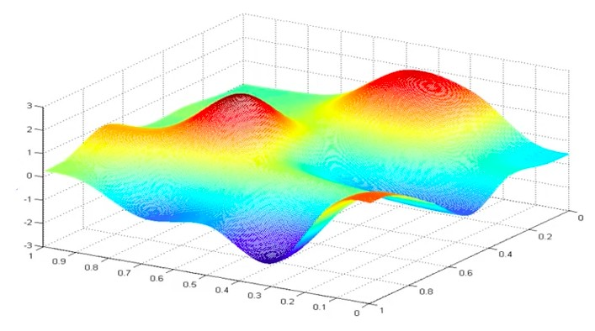
Loss Optimization
𝜽∗ = argmin 𝐽(𝜽)
𝜽
Remember:
Our loss is a function of the network weights!
𝐽(𝜃/, �# )
�#
𝜃
/
6.S191 Introduction to Deep Learning
introtodeeplearning.com
1/29/18

Slide 46
Loss Optimization
Randomly pick an initial (𝜃/, �#)
𝐽(𝜃/, �# )
�#
𝜃
/
6.S191 Introduction to Deep Learning
introtodeeplearning.com
1/29/18

Slide 47
Loss Optimization
Compute gradient, ^{jk(𝜽)}
j𝜽
𝐽(𝜃/, �# )
�#
𝜃
/
6.S191 Introduction to Deep Learning
introtodeeplearning.com
1/29/18

Slide 48
Loss Optimization
Take small step in opposite direction of gradient
𝐽(𝜃/, �# )
�#
𝜃
/
6.S191 Introduction to Deep Learning
introtodeeplearning.com
1/29/18

Slide 49
Gradient Descent
Repeat until convergence
𝐽(𝜃/, �# )
�#
𝜃
/
6.S191 Introduction to Deep Learning
introtodeeplearning.com
1/29/18

Slide 50
Gradient Descent
Algorithm
Initialize weights randomly ~𝒩(0, 𝜎%)
Loop until convergence: 3.
weights = tf.random_normal(shape, stddev=sigma)
Compute gradient, ^{jk(n)}
grads = tf.gradients(ys=loss, xs=weights)
weights_new = weights.assign(weights – lr * grads)
jn
4.
Update weights, 𝜃← 𝜃− 𝜂^{jk(n)}
jn
5. Return weights
6.S191 Introduction to Deep Learning
introtodeeplearning.com
1/29/18

Slide 51
Gradient Descent
Algorithm
Initialize weights randomly ~𝒩(0, 𝜎%)
Loop until convergence: 3.
weights = tf.random_normal(shape, stddev=sigma)
Compute gradient, ^{jk(n)}
grads = tf.gradients(ys=loss, xs=weights)
weights_new = weights.assign(weights – lr * grads)
jn
4.
Update weights, 𝜃← 𝜃− 𝜂^{jk(n)}
jn
5. Return weights
6.S191 Introduction to Deep Learning
introtodeeplearning.com
1/29/18

Slide 52
Computing Gradients: Backpropagation
�#
𝜃%
𝑥
𝑧#
�)
𝐽(𝜽)
How does a small change in one weight (ex. 𝜃%) affect the final loss 𝐽(𝜽)?
6.S191 Introduction to Deep Learning
introtodeeplearning.com
1/29/18

Slide 53
Computing Gradients: Backpropagation
�#
𝜃%
𝑥
𝑧#
�)
𝐽(𝜽)
𝜕𝐽(𝜽)
=
𝜕𝜃%
Let’s use the chain rule!
6.S191 Introduction to Deep Learning
introtodeeplearning.com
1/29/18

Slide 54


Computing Gradients: Backpropagation
�#
𝜃%
𝑥
𝑧#
�)
𝐽(𝜽)
𝜕𝐽(𝜽)
𝜕𝐽(𝜽)
𝜕�)
=
∗
𝜕𝜃%
𝜕�)
𝜕𝜃%
6.S191 Introduction to Deep Learning
introtodeeplearning.com
1/29/18

Slide 55
Computing Gradients: Backpropagation
�#
𝜃%
𝑥
𝑧#
�)
𝐽(𝜽)
𝜕𝐽(𝜽)
𝜕𝐽(𝜽)
𝜕�)
=
∗
𝜕�#
𝜕�)
𝜕�#
Apply chain rule!
Apply chain rule!
6.S191 Introduction to Deep Learning
introtodeeplearning.com
1/29/18

Slide 56

Computing Gradients: Backpropagation
�#
𝜃%
𝑥
𝑧#
�)
𝐽(𝜽)
𝜕𝐽(𝜽)
𝜕𝐽(𝜽)
𝜕�)
𝜕�#
=
∗
∗
𝜕�#
𝜕�)
𝜕�#
𝜕�#
6.S191 Introduction to Deep Learning
introtodeeplearning.com
1/29/18

Slide 57
Computing Gradients: Backpropagation
�#
𝜃%
𝑥
𝑧#
�)
𝐽(𝜽)
𝜕𝐽(𝜽)
𝜕𝐽(𝜽)
𝜕�)
𝜕�#
=
∗
∗
𝜕�#
𝜕�)
𝜕�#
𝜕�#
Repeat this for every weight in the network using gradients from later layers
6.S191 Introduction to Deep Learning
introtodeeplearning.com
1/29/18

Slide 58
Neural Networks in Practice: Optimization

Slide 59
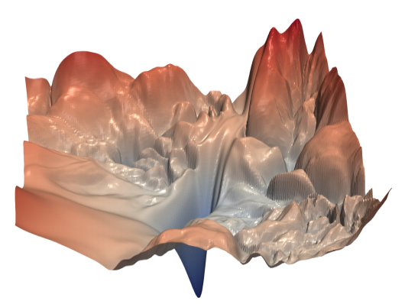
Training Neural Networks is Difficult
“Visualizing the loss landscape of neural nets”. Dec 2017.

Slide 60
Loss Functions Can Be Difficult to Optimize
Remember:
Optimization through gradient descent
𝜕𝐽(𝜃)
𝜃← 𝜃− 𝜂
𝜕𝜃

Slide 61
Loss Functions Can Be Difficult to Optimize
Remember:
Optimization through gradient descent
𝜕𝐽(𝜃)
𝜃← 𝜃− 𝜂
𝜕𝜃
How can we set the learning rate?

Slide 62
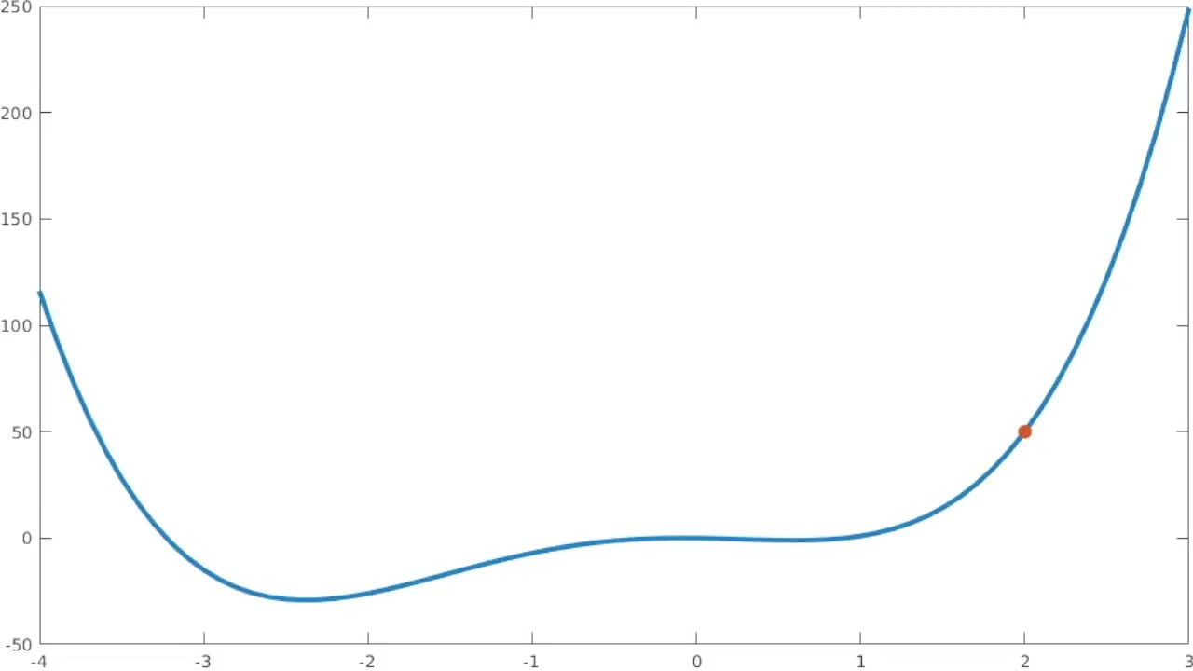
Setting the Learning Rate
Small learning rate converges slowly and gets stuck in false local minima
𝐽(𝜽)
Initial guess
𝜃
6.S191 Introduction to Deep Learning
introtodeeplearning.com
1/29/18

Slide 63

Setting the Learning Rate
Large learning rates overshoot, become unstable and diverge
𝐽(𝜽)
Initial guess
𝜃
6.S191 Introduction to Deep Learning
introtodeeplearning.com
1/29/18

Slide 64

Setting the Learning Rate
Stable learning rates converge smoothly and avoid local minima
𝐽(𝜽)
Initial guess
𝜃
6.S191 Introduction to Deep Learning
introtodeeplearning.com
1/29/18

Slide 65
How to deal with this?
Idea 1:
Try lots of different learning rates and see what works “just right”
6.S191 Introduction to Deep Learning
introtodeeplearning.com
1/29/18

Slide 66
How to deal with this?
Idea 1:
Try lots of different learning rates and see what works “just right”
Idea 2:
Do something smarter!
Design an adaptive learning rate that “adapts” to the landscape
6.S191 Introduction to Deep Learning
introtodeeplearning.com
1/29/18

Slide 67
Adaptive Learning Rates
Learning rates are no longer fixed
Can be made larger or smaller depending on:
how large gradient is
how fast learning is happening
size of particular weights
etc...
6.S191 Introduction to Deep Learning
introtodeeplearning.com
1/29/18

Slide 68
Adaptive Learning Rate Algorithms
Qian et al. “On the momentum term in gradient
Momentum
Adagrad
Adadelta
Adam
RMSProp
tf.train.MomentumOptimizer
descent learning algorithms.” 1999.
Duchi et al. “Adaptive Subgradient Methods for Online Learning and Stochastic Optimization.” 2011.
tf.train.AdagradOptimizer
tf.train.AdadeltaOptimizer
Zeiler et al. “ADADELTA: An Adaptive Learning Rate Method.” 2012.
tf.train.AdamOptimizer
Kingma et al. “Adam: A Method for Stochastic Optimization.” 2014.
tf.train.RMSPropOptimizer
Additional details: http://ruder.io/optimizing-gradient-descent/
6.S191 Introduction to Deep Learning
introtodeeplearning.com
1/29/18

Slide 69
Neural Networks in Practice: Mini-batches

Slide 70
Gradient Descent
Algorithm
Initialize weights randomly ~𝒩(0, 𝜎%)
Loop until convergence: 3.
Compute gradient, ^{jk(n)}
jn
4.
Update weights, 𝜃← 𝜃− 𝜂^{jk(n)}
jn
5. Return weights

Slide 71
Gradient Descent
Algorithm
Initialize weights randomly ~𝒩(0, 𝜎%)
Loop until convergence: 3.
Compute gradient, ^{jk(n)}
jn
4.
Update weights, 𝜃← 𝜃− 𝜂^{jk(n)}
jn
5. Return weights
Can be very
computational to compute!

Slide 72
Stochastic Gradient Descent
Algorithm
Initialize weights randomly ~𝒩(0, 𝜎%)
Loop until convergence:
Pick single data point 𝑖 4.
Compute gradient, ^{jks(n)}
jn
5.
Update weights, 𝜃← 𝜃− 𝜂^{jk(n)}
jn
6. Return weights

Slide 73
Stochastic Gradient Descent
Algorithm
Initialize weights randomly ~𝒩(0, 𝜎%)
Loop until convergence:
Pick single data point 𝑖 4.
Compute gradient, ^{jks(n)}
jn
5.
Update weights, 𝜃← 𝜃− 𝜂^{jk(n)}
jn
6. Return weights
Easy to compute but
very noisy
(stochastic)!

Slide 74
Stochastic Gradient Descent
Algorithm
Initialize weights randomly ~𝒩(0, 𝜎%)
Loop until convergence:
Pick batch of 𝐵data points 4.
₌ # _{∑u}
jk[ (n)
Compute gradient, ^{jk(n)}
jn u
Z.#
jn
5.
Update weights, 𝜃← 𝜃− 𝜂^{jk(n)}
jn
6. Return weights

Slide 75
Stochastic Gradient Descent
Algorithm
Initialize weights randomly ~𝒩(0, 𝜎%)
Loop until convergence:
Pick batch of 𝐵data points 4.
₌ # _{∑u}
jk[ (n)
Compute gradient, ^{jk(n)}
jn u
Z.#
jn
5.
Update weights, 𝜃← 𝜃− 𝜂^{jk(n)}
jn
6. Return weights
Fast to compute and a much better estimate of the true gradient!

Slide 76
Mini-batches while training
More accurate estimation of gradient
Smoother convergence Allows for larger learning rates

Slide 77
Mini-batches while training
More accurate estimation of gradient
Smoother convergence Allows for larger learning rates
Mini-batches lead to fast training!
Can parallelize computation + achieve significant speed increases on GPU’s

Slide 78
Neural Networks in Practice: Overfitting

Slide 79
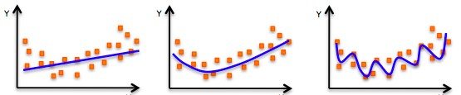
The Problem of Overfitting
Underfitting
Model does not have capacity to fully learn the data
Ideal fit
Overfitting
Too complex, extra parameters, does not generalize well

Slide 80
Regularization 2: Early Stopping
Stop training before we have a chance to overfit
Loss
Training Iterations
6.S191 Introduction to Deep Learning
introtodeeplearning.com
1/29/18

Slide 81
Regularization 2: Early Stopping
Stop training before we have a chance to overfit
Legend
Loss
Testing
Training
Training Iterations
6.S191 Introduction to Deep Learning
introtodeeplearning.com
1/29/18

Slide 82
Regularization 2: Early Stopping
Stop training before we have a chance to overfit
Legend
Loss
Te sting
Training
Training Iterations
6.S191 Introduction to Deep Learning
introtodeeplearning.com
1/29/18

Slide 83
Regularization 2: Early Stopping
Stop training before we have a chance to overfit
Legend
Loss
Testing
Training
Training Iterations
6.S191 Introduction to Deep Learning
introtodeeplearning.com
1/29/18

Slide 84
Regularization 2: Early Stopping
Stop training before we have a chance to overfit
Legend
Loss
Testing
Training
Training Iterations
6.S191 Introduction to Deep Learning
introtodeeplearning.com
1/29/18

Slide 85
Regularization 2: Early Stopping
Stop training before we have a chance to overfit
Legend
Loss
Testing
Training
Training Iterations
6.S191 Introduction to Deep Learning
introtodeeplearning.com
1/29/18

Slide 86
Regularization 2: Early Stopping
Stop training before we have a chance to overfit
Legend
Loss
Stop training here!
Testing
Training
Training Iterations
6.S191 Introduction to Deep Learning
introtodeeplearning.com
1/29/18

Slide 87
Regularization 2: Early Stopping
Stop training before we have a chance to overfit
Under-fitting
Over-fitting
Legend
Loss
Stop training here!
Testing
Training
Training Iterations
6.S191 Introduction to Deep Learning
introtodeeplearning.com
1/29/18

Slide 88
Core Foundation Review
The Perceptron
Neural Networks
Training in Practice
Structural building blocks
Nonlinear activation functions
Stacking Perceptrons to form neural networks
Optimization through backpropagation
Adaptive learning
Batching
Regularization
𝑥#
𝑥#
^{𝑧}Z,#
𝑥%
Σ
�)
^{𝑧}Z,%
�)#
𝑥%
⋯
⋯
^{𝑧}Z,W
�)%
𝑥$
𝑥$
^{𝑧}Z,X[
6.S191 Introduction to Deep Learning
introtodeeplearning.com
1/29/18

Slide 89
Questions?

